Slide 1


Mobile Museum App
Project Presentation
Speaker: Invalid Read of Size 8

Slide 2
O
N
E
Plan Change
&
Current Achievements

Slide 3
A Quick Review of Our Plan
General Plan：
An Museum App which can display the information of exhibits
Users can have their own accounts to save their “Favorites” and purchase tickets

Slide 4
Review and Change
Sprint 1： 02/19/2018 - 03/11/2018 15PW
Database and communication between back and front
Display function
Sprint 2： 03/12/2018 - 04/01/2018 15PW
Login and register page
Searching items and random recommendation
Main interface design
Sprint 3： 04/02/2018 - 04/12/2018 10PW
“Favorite” folder
Ticket Purchasing
“View history”

Slide 5
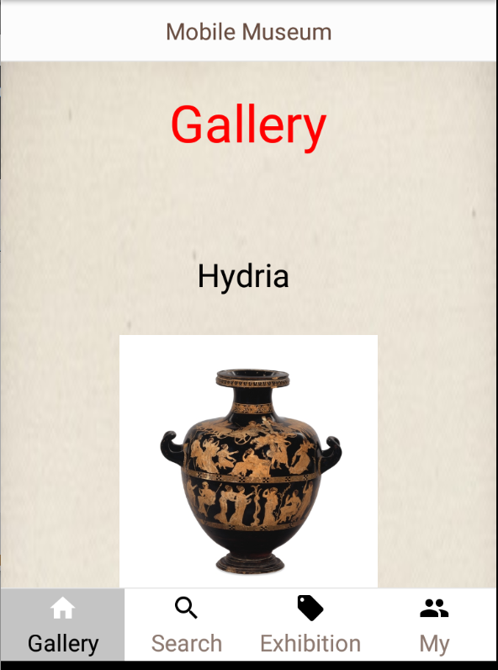
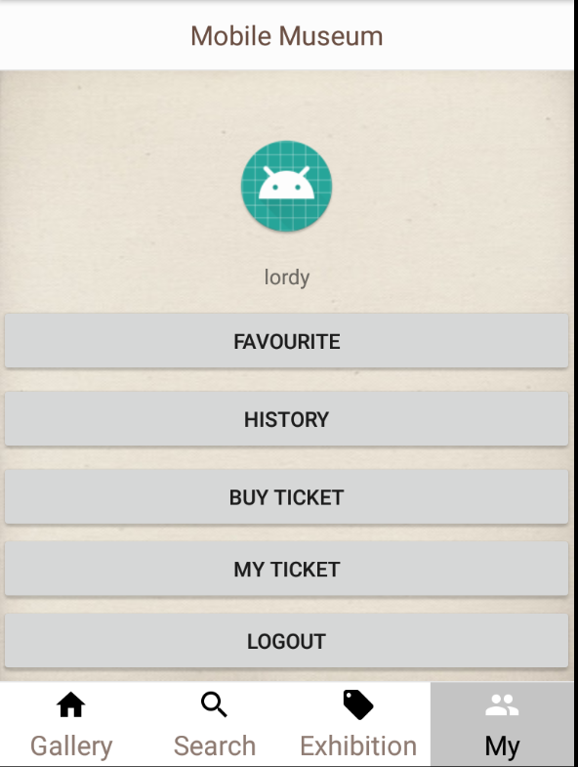
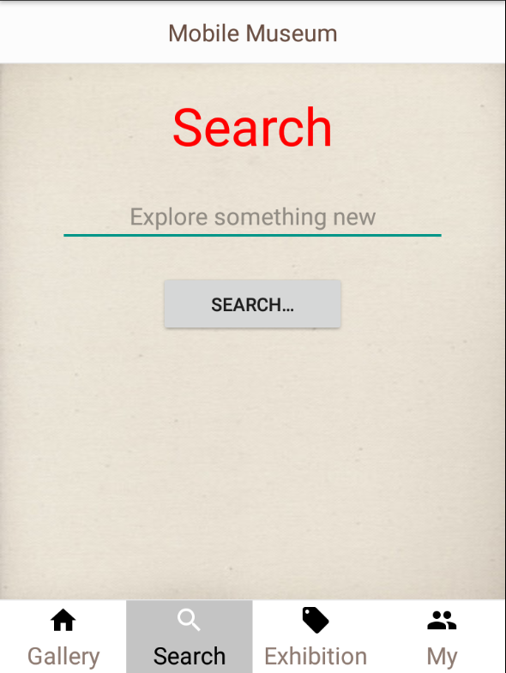
UI design
Random Recommendation
Login Logout Register
Favorite & History
Ticket Purchasing
Item searching
Detail Display

Slide 6
T
W
O
Test

Slide 7
Test Plan
Testing：
Component testing throughout the process, every time when one part finishes; System testing start when the first two parts finishes;
Testing: Whole Group, Front-end team a little bit more work

Slide 8
What have we done?
Test Description | Category | Expected Results | Owner | Result
Present returned data from a function to the UI | Unit Testing | The displayed data is the returned value from the function. | Qian Fang, Yan Su | Pass
Click an image button and change the UI to another view with a particular data send along, display the ID on the new view. | Unit Testing | The ID will be properly displayed and will be the same as the image clicked. | Qian Fang, Yan Su | Pass
Sending data via HTTP request to the server and get the response | Unit Testing (automated using JUnit) | Responded data is “hello” on success and the front-end will return “hello” or the server will respond nothing and the front-end will return “failed”. | You Lyu | Pass
Sending item name via HTTP request to the server and get particular response | Unit Testing (automated using JUnit) | Responded data is the item’s information if the combination is valid, if the combination is invalid, the response will be text: “item does not exist”. | You Lyu, Zhongyu Li | Pass
Present item’s detailed information | Component Testing | The view will change to a new one and the detailed information will be displayed. | Qian Fang, Yan Su | Pass

Slide 9
What have we done?
Test Description | Category | Expected Results | Owner | Result
Random Recommendation of different item | Component Testing | Each time the result is different, and the information is correct | Qian Fang, Yan Su | In some cases pictures may not be loaded
After submitting, get user’s input to the specific element of UI and display input | Unit Testing | None if nothing is input, and the exact content of input is input is valid (if it is too long, it may go out of the display box’s scope, and in this case, it can be ignored as the actually displayed text data will have limited length). | Qian Fang, Yan Su | Pass
User’s account information is not accessible if user is not logged in (i.e. update user’s status) | Unit Testing | Able to access user’s information; Unable to access user’s information; | You Lyu, Zhongyu Li | Pass
User Registration and logging in | Component Testing | The user account section will be accessible, and user’s information will be presented on the page. | You Lyu, Zhongyu Li | Pass
User logging out | Component Testing | The user account section will not be accessible and when clicked on the corresponding tab, a prompting window will be popped out to alert that the user should login first and the view will jump to the login view. | You Lyu | Pass

Slide 10
What plan to do ?
Test Descripion | Category | Possible test case | Expected result | Owner
Clicking on the ‘purchase’ button to see if it will change to the ticket purchasing page | Unit Testing | Click on the purchase button on the main page or in the user account page. | The page should be changed to the ticket purchase page. If the user has not logged in yet, the system should remind the user to login first. | Qian Fang, Yan Su
Checking if the system can get the correct user bank account information. | Unit Testing | Send some specific users’ account the server to acquire the corresponding bank account information. | If the user has already registered his bank account in the database, the server should send back the information in the database. If not, the server should send a message to tell the front-end that there is no matching information. | Zhongyu Li, You Lyu
Checking if the rolling part of the ticket purchasing page works correctly | Unit Testing | Roll up and down on the rolling part of the ticket purchasing page to check if it will perform well. | The page will roll up and down for the users to scan all the available tickets and corresponding exhibitions. | Zhongyu Li, Rongsheng Zhang
Checking if the users’ purchasing status will be stored in the server correctly. | Unit Testing | Log in as a user and purchase the tickets of some exhibitions. | The user’s information should be sent to the server and be stored in the database. | You Lyu, Yan Su
‘Favorite’ items | Component Testing | Clicking the ‘favorite’ button to add the item to the favorite items list on the user account information. | If logged in, the item will be added and displayed on the user account information; else, ‘favorite’ is not operable. | Rongsheng Zhang

Slide 11
T
H
R
E
E
Sprint Review

Slide 12
Sprint Review
1. Never underestimate the workload
2. Balance the workload and give each sprint appropriate amount of work
3. Take advantage of version control platform like gitlab
4. Before development, agree on the interface or the method that will be used in the project

Slide 13
D
E
M
O

